Slide 1
AVL Tree
Prepared by: Afaq Mansoor Khan
BSSE III- Group A
Session 2017-21
IMSciences, Peshawar.

Slide 2
Last Lecture Summary
Recursive and Non Recursive Traversal of Binary/Binary Search Tree
In-Order Traversal
Pre-Order Traversal
Post-Order Traversal
Searching in a Binary Search Tree

Slide 3
Objectives Overview
Introduction to AVL tree
Insertion and deletion of a node in AVL tree.
Balancing of Tree
Calculating Height of a particular node in the Tree
Calculating balance Factor for a particular Node in the Tree
Left Rotation in an AVL Tree
Right Rotation in an AVL Tree
All types of Traversals in AVL
Algorithm Analysis

Slide 4
Definition of an AVL tree
AVL tree is a self-balancing Binary Search Tree (BST) where the difference between heights of left and right subtrees cannot be more than one for all nodes.
It has the following properties:
The sub-trees of every node differ in height by at most one.
Every sub-tree is an AVL tree.

Slide 5
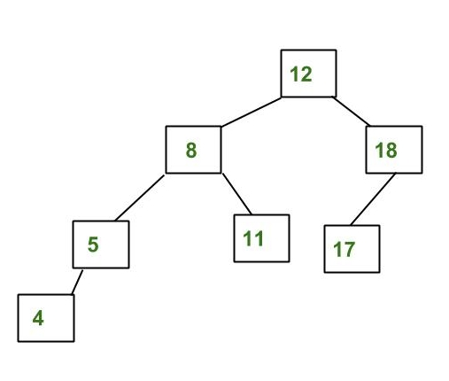
Example Tree of an AVL Tree
The above tree is AVL because differences between heights of left and right subtrees for every node is less than or equal to 1.

Slide 6
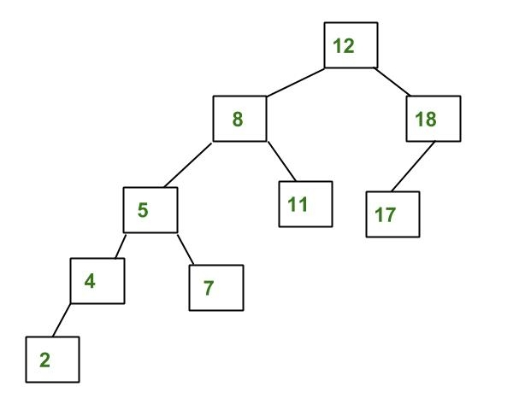
An Example Tree that is NOT an AVL Tree
The above tree is not AVL because differences between heights of left and right subtrees for 8 and 18 is greater than 1.

Slide 7
Why AVL Trees?
Most of the BST operations (e.g., search, max, min, insert, delete.. etc) take O(h) time where h is the height of the BST. The cost of these operations may become O(n) for a skewed Binary tree. If we make sure that height of the tree remains O(Logn) after every insertion and deletion, then we can guarantee an upper bound of O(Logn) for all these operations. The height of an AVL tree is always O(Logn) where n is the number of nodes in the tree.

Slide 8
Insertion in AVL Tree

Slide 9
Insertion
To make sure that the given tree remains AVL after every insertion, we must augment the standard BST insert operation to perform some re-balancing. Following are two basic operations that can be performed to re-balance a BST without violating the BST property (keys(left) < key(root) < keys(right)).
Left Rotation
Right Rotation

Slide 10
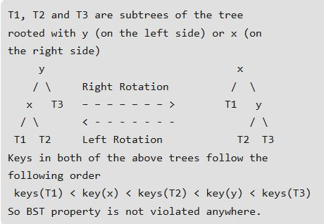

Slide 11
Insertion - Algorithm
Steps: Let the newly inserted node be w
Perform standard BST insert for w.
Starting from w, travel up and find the first unbalanced node. Let z be the first unbalanced node, y be the child of z that comes on the path from w to z and x be the grandchild of z that comes on the path from w to z.
Re-balance the tree by performing appropriate rotations on the subtree rooted with z.

Slide 12
Four Possible Arrangements
There can be 4 possible cases that needs to be handled as x, y and z can be arranged in 4 ways. Following are the possible 4 arrangements:
y is left child of z and x is left child of y (Left-Left Case)
y is left child of z and x is right child of y (Left-Right Case)
y is right child of z and x is right child of y (Right-Right Case)
y is right child of z and x is left child of y (Right-Left Case)

Slide 13
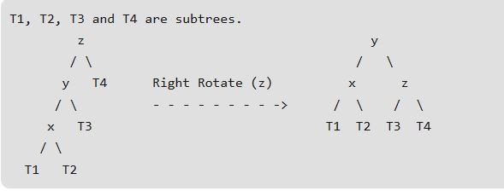
Left-Left Case

Slide 14
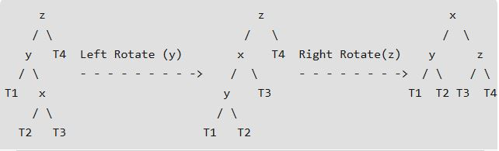
Left-Right Case

Slide 15
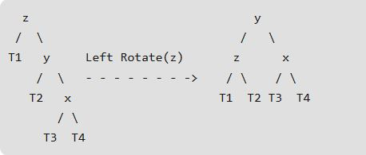
Right-Right Case

Slide 16
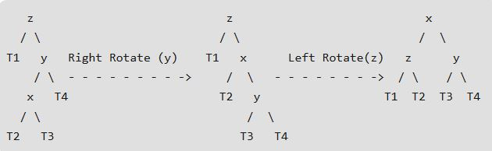
Right-Left Case

Slide 17
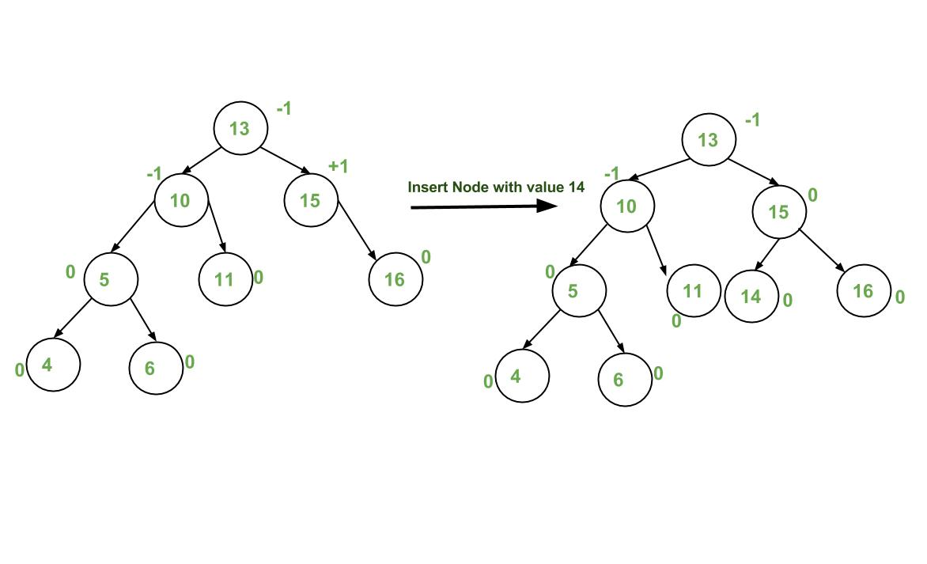
Insertion Examples

Slide 18
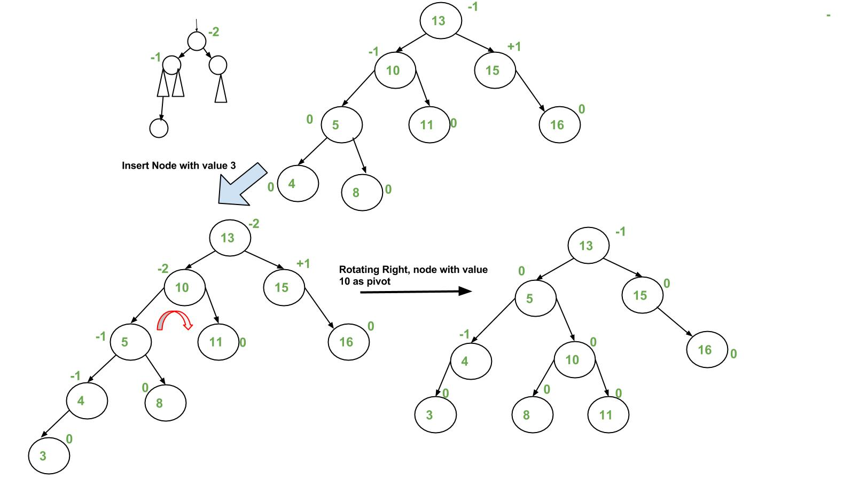
Insertion Examples

Slide 19
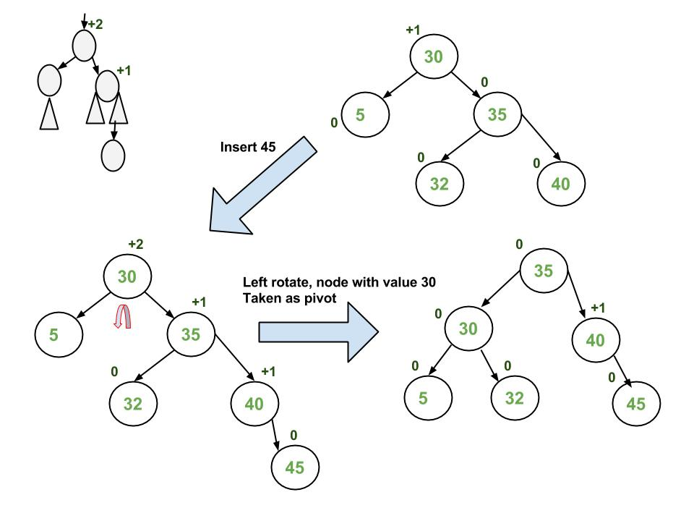
Insertion Examples

Slide 20
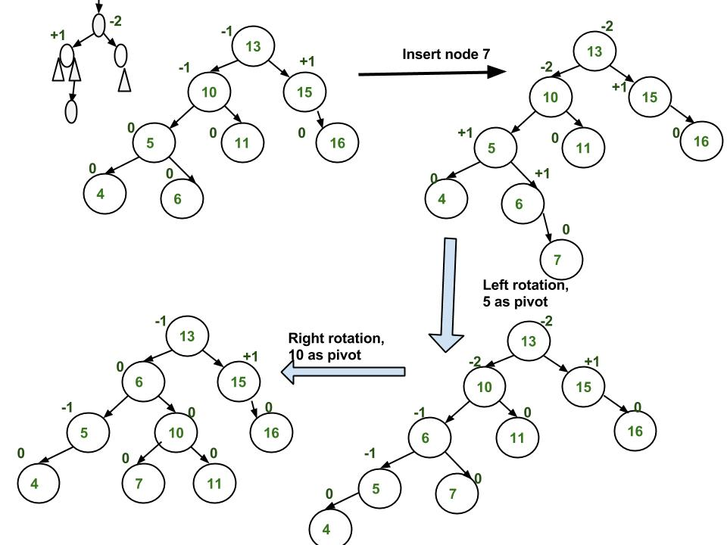
Insertion Examples

Slide 21
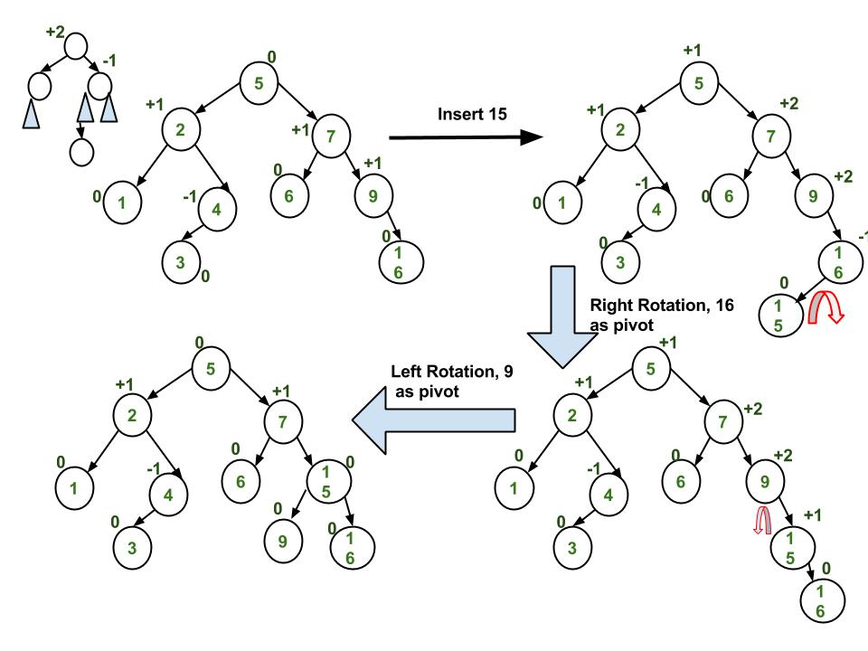
Insertion Examples

Slide 22
Implementation
This implementation uses the recursive BST insert to insert a new node. In the recursive BST insert, after insertion, we get pointers to all ancestors one by one in a bottom-up manner. So we don’t need parent pointer to travel up. The recursive code itself travels up and visits all the ancestors of the newly inserted node.
Perform the normal BST insertion.
The current node must be one of the ancestors of the newly inserted node. Update the height of the current node.
Get the balance factor (left subtree height – right subtree height) of the current node.
If balance factor is greater than 1, then the current node is unbalanced and we are either in Left-Left case or left Right case. To check whether it is left-left case or not, compare the newly inserted key with the key in left subtree root.
If balance factor is less than -1, then the current node is unbalanced and we are either in Right-Right case or Right-Left case. To check whether it is Right-Right case or not, compare the newly inserted key with the key in right subtree root.

Slide 23
Implementation
struct Node* insert(struct Node* node, int key)
{
if (node == NULL)
return(newNode(key));
if (key < node->key)
node->left = insert(node->left, key);
else if (key > node->key)
node->right = insert(node->right, key);
else return node;
node->height = 1 + max(height(node->left),
height(node->right));
int balance = getBalance(node);
if (balance > 1 && key < node->left->key) // Left Left Case
return rightRotate(node);
if (balance < -1 && key > node->right->key) // Right Right Case
return leftRotate(node);
if (balance > 1 && key > node->left->key) // Left Right Case
{
node->left = leftRotate(node->left);
return rightRotate(node);
}
if (balance < -1 && key < node->right->key) // Right Left Case
{
node->right = rightRotate(node->right);
return leftRotate(node);
}
return node;
}

Slide 24
Time Complexity
The rotation operations (left and right rotate) take constant time as only a few pointers are being changed there. Updating the height and getting the balance factor also takes constant time. So the time complexity of AVL insert remains same as BST insert which is O(h) where h is the height of the tree. Since AVL tree is balanced, the height is O(Logn). So time complexity of AVL insert is O(Logn).

Slide 25
Deletion in AVL Tree

Slide 26
Deletion
To make sure that the given tree remains AVL after every deletion, we must augment the standard BST delete operation to perform some re-balancing. Following are two basic operations that can be performed to re-balance a BST without violating the BST property (keys(left) < key(root) < keys(right)).
Left Rotation
Right Rotation

Slide 27
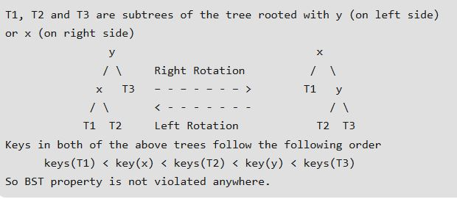

Slide 28
Deletion - Algorithm
Steps:
Let w be the node to be deleted
Perform standard BST delete for w.
Starting from w, travel up and find the first unbalanced node. Let z be the first unbalanced node, y be the larger height child of z, and x be the larger height child of y. Note that the definitions of x and y are different from insertion here.
Re-balance the tree by performing appropriate rotations on the subtree rooted with z.

Slide 29
Four Possible Arrangements
There can be 4 possible cases that needs to be handled as x, y and z can be arranged in 4 ways. Following are the possible 4 arrangements:
y is left child of z and x is left child of y (Left-Left Case)
y is left child of z and x is right child of y (Left-Right Case)
y is right child of z and x is right child of y (Right-Right Case)
y is right child of z and x is left child of y (Right-Left Case)

Slide 30
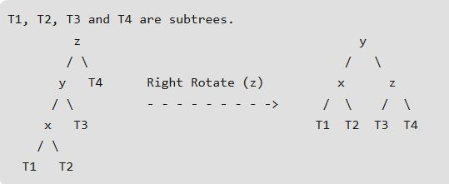
Left-Left Case

Slide 31
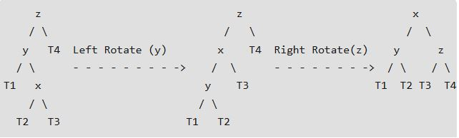
Left-Right Case

Slide 32
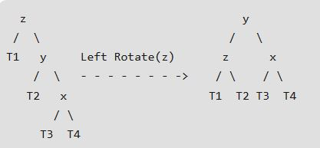
Right-Right Case

Slide 33
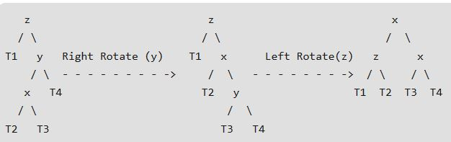
Right-Left Case

Slide 34
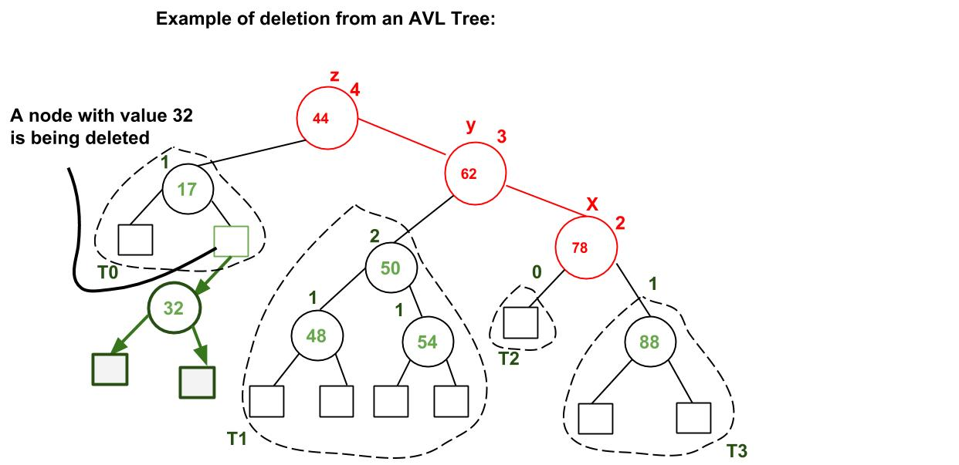
Deletion Examples

Slide 35
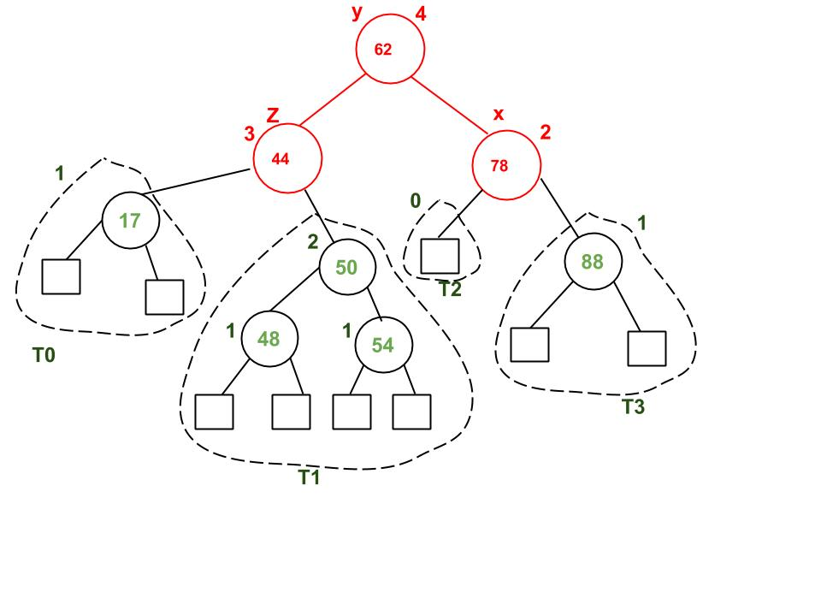
Deletion Examples

Slide 36
Implementation
The following implementation uses the recursive BST delete as basis. In the recursive BST delete, after deletion, we get pointers to all ancestors one by one in bottom up manner. So we don’t need parent pointer to travel up. The recursive code itself travels up and visits all the ancestors of the deleted node.
Perform the normal BST deletion.
The current node must be one of the ancestors of the deleted node. Update the height of the current node.
Get the balance factor (left subtree height – right subtree height) of the current node.
If balance factor is greater than 1, then the current node is unbalanced and we are either in Left Left case or Left Right case. To check whether it is Left Left case or Left Right case, get the balance factor of left subtree. If balance factor of the left subtree is greater than or equal to 0, then it is Left Left case, else Left Right case.
If balance factor is less than -1, then the current node is unbalanced and we are either in Right Right case or Right Left case. To check whether it is Right Right case or Right Left case, get the balance factor of right subtree. If the balance factor of the right subtree is smaller than or equal to 0, then it is Right Right case, else Right Left case.

Slide 37
Implementation
struct Node* deleteNode(struct Node* root, int key)
{
if (root == NULL)
return root;
if ( key < root->key )
root->left = deleteNode(root->left, key);
else if( key > root->key )
root->right = deleteNode(root->right, key);
else
{
if( (root->left == NULL) || (root->right == NULL) )
{
struct Node *temp = root->left ? root->left :
root->right;
if (temp == NULL)
{
temp = root;
root = NULL;
}
else
*root = *temp;
free(temp);
}
else
{
struct Node* temp = minValueNode(root->right);
root->key = temp->key;
root->right = deleteNode(root->right, temp->key);
}
}
if (root == NULL)
return root;

Slide 38
Implementation
root->height = 1 + max(height(root->left),
height(root->right));
int balance = getBalance(root);
if (balance > 1 && getBalance(root->left) >= 0) // Left Left Case
return rightRotate(root);
if (balance > 1 && getBalance(root->left) < 0) // Left Right Case
{
root->left = leftRotate(root->left);
return rightRotate(root);
}
if (balance < -1 && getBalance(root->right) <= 0) // Right Right Case
return leftRotate(root);
if (balance < -1 && getBalance(root->right) > 0) // Right Left Case
{
root->right = rightRotate(root->right);
return leftRotate(root);
}
return root;
}

Slide 39
Time Complexity
The rotation operations (left and right rotate) take constant time as only few pointers are being changed there. Updating the height and getting the balance factor also take constant time. So the time complexity of AVL delete remains same as BST delete which is O(h) where h is height of the tree. Since AVL tree is balanced, the height is O(Logn). So time complexity of AVL delete is O(Log n).

Slide 40
Balancing of Tree

Slide 41
Trees and balance
Balanced tree: One whose subtrees differ in height by at most 1 and are themselves balanced.
A balanced tree of N nodes has a height of ~ log₂ N.
A very unbalanced tree can have a height close to N.
The runtime of adding to / searching a BST is closely related to height.
Some tree collections (e.g. TreeSet) contain code to balance themselves as new nodes are added.
root
9
6
14
4
8
19
height = 4
(balanced)
7

Slide 42
Some height numbers
Observation: The shallower the BST the better.
Average case height is O(log N)
Worst case height is O(N)
Simple cases such as adding (1, 2, 3, ..., N), or the opposite order, lead to the worst case scenario: height O(N).
For binary tree of height h:
max # of leaves: 2^{h-1}
max # of nodes: 2^{h} - 1
min # of leaves: 1
min # of nodes: h
root
15
8
20
2
14
18
21

Slide 43
Calculating tree height
Height is max number of nodes in path from root to any leaf.
height(null) = 0
height(a leaf) = ?
height(A) = ?
Hint: it's recursive!
height(a leaf) = 1
height(A) = 1 + max( height(A.left), height(A.right))
A
A.left
A.right

Slide 44
Balance factor
Balance factor, for a tree node T :
= height of T's right subtree minus height of T's left subtree.
BF(T) = Height(T.right) - Height(T.left)
(the tree at right shows BF of each node)
an AVL tree maintains a "balance factor" in each node of 0, 1, or -1
i.e. no node's two child subtrees differ in height by more than 1
it can be proven that the height of an AVL tree with N nodes is O(log N)
-2
3
1
-2
0
-1
0

Slide 45
Pros and Cons of AVL Trees
Arguments for AVL trees:
Search is O(log N) since AVL trees are always balanced.
Insertion and deletions are also O(logn)
The height balancing adds no more than a constant factor to the speed of insertion.
Arguments against using AVL trees:
Difficult to program & debug; more space for balance factor.
Asymptotically faster but rebalancing costs time.
Most large searches are done in database systems on disk and use other structures (e.g. B-trees).
May be OK to have O(N) for a single operation if total run time for many consecutive operations is fast (e.g. Splay trees).

Slide 46
Traversing the Tree

Slide 47
Traversing the Tree
Unlike linear data structures (Array, Linked List, Queues, Stacks, etc) which have only one logical way to traverse them, trees can be traversed in different ways.
There are three simple ways to traverse a tree:
Inorder
Preorder
Postorder
Each of these methods is best implemented as a recursive function.

Slide 48
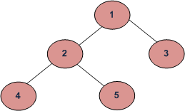
Simple ways to traverse a tree:
Inorder (Left, Root, Right) : 4 2 5 1 3
Preorder (Root, Left, Right) : 1 2 4 5 3
Postorder (Left, Right, Root) : 4 5 2 3 1

Slide 49
Inorder Traversing using Recursion
Inorder traversal will cause all the nodes to be visited in ascending order.
Steps involved in Inorder traversal (recursion) are:
-- Call itself to traverse the node’s left subtree
-- Visit the node (e.g. display a key)
-- Call itself to traverse the node’s right subtree.

Slide 50
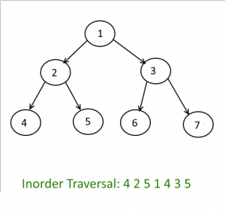
Inorder Traversing

Slide 51
Inorder Traversal
The node’s left subtree is traversed.
The node’s data is processed.
The node’s right subtree is traversed.

Slide 52
Inorder Traversing - Algorithm
Traverse the left subtree, i.e., call Inorder(left-subtree)
Visit the root.
Traverse the right subtree, i.e., call Inorder(right-subtree)

Slide 53
Inorder Traversing - Implementation
In inorder, the root is visited in the middle
Here’s an inorder traversal to print out all the elements in the binary tree:
public void inorderPrint(BinaryTree bt) { if (bt == null) return; inorderPrint(bt.leftChild); System.out.println(bt.value); inorderPrint(bt.rightChild); }

Slide 54
Non Recursive Inorder Traversing
Create an empty stack S.
Initialize current node as root
Push the current node to S and set current = current->left until current is NULL
If current is NULL and stack is not empty then:
Pop the top item from stack.
Print the popped item, set current = popped_item->right
Go to step 3.
If current is NULL and stack is empty then we are done.

Slide 55
Preorder Traversing using Recursion
Sequence of preorder traversal: e.g. use for infix parse tree to generate prefix
Steps involved in Preorder traversal (recursion) are:
-- Visit the node
-- Call itself to traverse the node’s left subtree
-- Call itself to traverse the node’s right subtree

Slide 56
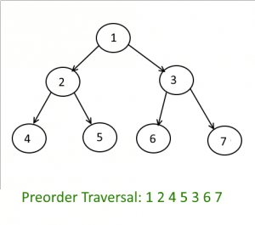
Preorder Traversing

Slide 57
Preorder Traversal
The node’s data is processed.
The node’s left subtree is traversed.
The node’s right subtree is traversed.

Slide 58
Preorder Traversing - Algorithm
Visit the root.
Traverse the left subtree, i.e., call Preorder(left-subtree)
Traverse the right subtree, i.e., call Preorder(right-subtree)

Slide 59
Preorder Traversing - Implementation
In preorder, the root is visited first
Here’s a preorder traversal to print out all the elements in the binary tree:
public void preorderPrint(BinaryTree bt) { if (bt == null) return; System.out.println(bt.value); preorderPrint(bt.leftChild); preorderPrint(bt.rightChild); }

Slide 60
Non Recursive Preorder Traversing
Create a Stack.
Print the root and push it to Stack and go left
i.e root=root.left and till it hits the NULL.
If root is null and Stack is empty then
return, we are done.
Else
Pop the top Node from the Stack and set it as, root = popped_Node.
Go right, root = root.right.
Go to step 2.
End If

Slide 61
Postorder Traversing using Recursion
Sequence of postorder traversal: e.g. use for infix parse tree to generate postfix
Steps involved in Postorder traversal (recursion) are:
-- Call itself to traverse the node’s left subtree
-- Call itself to traverse the node’s right subtree
-- Visit the node.

Slide 62
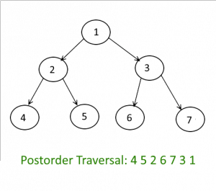
Postorder Traversing

Slide 63
Postorder Traversal
The node’s left subtree is traversed.
The node’s right subtree is traversed.
The node’s data is processed.

Slide 64
Postorder traversal - Algorithm
Traverse the left subtree, i.e., call Postorder(left-subtree)
Traverse the right subtree, i.e., call Postorder(right-subtree)
Visit the root.

Slide 65
Postorder traversal - Implementation
In postorder, the root is visited last
Here’s a postorder traversal to print out all the elements in the binary tree:
public void postorderPrint(BinaryTree bt) { if (bt == null) return; postorderPrint(bt.leftChild); postorderPrint(bt.rightChild); System.out.println(bt.value); }

Slide 66
Non Recursive Preorder Traversing
Push root into Stack_One.
while(Stack_One is not empty)
Pop the node from Stack_One and push it into Stack_Two.
Push the left and right child nodes of popped node into Stack_One.
End Loop
Pop out all the nodes from Stack_Two and print it.

Slide 67
Algorithm Analysis
Time Complexity: O(n) Let us see different corner cases. Complexity function T(n) — for all problem where tree traversal is involved — can be defined as:
T(n) = T(k) + T(n – k – 1) + c
Where k is the number of nodes on one side of root and n-k-1 on the other side.
Let’s do an analysis of boundary conditions
Case 1: Skewed tree (One of the subtrees is empty and other subtree is non-empty )
k is 0 in this case. T(n) = T(0) + T(n-1) + c T(n) = 2T(0) + T(n-2) + 2c T(n) = 3T(0) + T(n-3) + 3c T(n) = 4T(0) + T(n-4) + 4c
………………………………………… …………………………………………. T(n) = (n-1)T(0) + T(1) + (n-1)c T(n) = nT(0) + (n)c
Value of T(0) will be some constant say d. (traversing a empty tree will take some constants time)
T(n) = n(c+d) T(n) = Θ(n) (Theta of n)
Case 2: Both left and right subtrees have equal number of nodes.
T(n) = 2T(|_n/2_|) + c
This recursive function is in the standard form (T(n) = aT(n/b) + (-)(n) ) for master method. If we solve it by master method we get (-)(n).
Auxiliary Space : If we don’t consider size of stack for function calls then O(1) otherwise O(n).

Slide 68
Summary
Introduction to AVL tree
Insertion and deletion of a node in AVL tree.
Balancing of Tree
Calculating Height of a particular node in the Tree
Calculating balance Factor for a particular Node in the Tree
Left Rotation in an AVL Tree
Right Rotation in an AVL Tree
All types of Traversals in AVL
Algorithm Analysis

Slide 69
References
https://www.geeksforgeeks.org/avl-tree-set-1-insertion/
https://courses.cs.washington.edu/courses/cse373/13wi/lectures/02.../16-avl-trees.ppt
https://www.geeksforgeeks.org/avl-tree-set-2-deletion/
https://crab.rutgers.edu/~guyk/avl.ppt
https://www.geeksforgeeks.org/binary-tree-data-structure/

